Slide 1
CGB1121 Python Programming
Academic Year: 2023 – 2024
I Year / II Semester
Register Number : 927623BCS011
Name : M S Arun Sanjeev
Department : Computer Science & Engineering

Slide 2
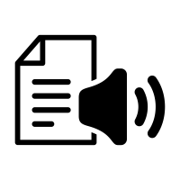
Title of the Project
TEXT – TO – VOICE CONVERTOR

Slide 3
Abstract
This project focuses on the development of a text-to-voice conversion system using Python. The system converts written text into spoken words, generating audio files that can be played back. It supports multiple languages and dialects, providing versatility for various applications. This technology can enhance accessibility for visually impaired users, automate announcements, and be integrated into various applications requiring voice outputs. The project demonstrates the integration of text-to-speech capabilities to create user-friendly and inclusive interfaces.

Slide 4
Abstract with CO/PO Mapping
Abstract | CO | POs | PSO
This project develops a text-to-voice conversion system in Python, turning written text into audio files. Supporting multiple languages, it enhances accessibility for visually impaired users and automates announcements. It demonstrates integrating text-to-speech for user-friendly interfaces. |  | PO1 (2) PO2 (3) PO3 (2) PO4 (2) PO5 (3) PO6 (1) PO7 (3) PO8 (2) PO9 (3) PO10 (3) PO11 (2) PO12 (2) | PSO1 (3) PSO2 (2)

Slide 5
Introduction
This project utilizes the Google Text-to-Speech (gTTS) library in Python to convert written text into spoken words. The gTTS library interfaces with Google's Text-to-Speech API, allowing for the generation of audio files from text inputs. This application can support various languages and dialects, providing flexibility for different use cases. The project demonstrates the integration of text-to-speech capabilities into Python applications, enabling the development of accessible and user-friendly interfaces for the visually impaired or for automated announcements.

Slide 6
CONCEPT Used
This project employs text-to-speech (TTS) technology to transform written text into audible speech using Python. The system generates audio files from text input, supporting multiple languages and dialects to cater to diverse user needs. TTS technology is pivotal in enhancing accessibility, particularly for visually impaired users, by providing an auditory alternative to written content. Additionally, it serves various practical applications such as automated announcements and voice-enabled interfaces. This project demonstrates the effective integration of TTS technology to develop inclusive, user-friendly, and accessible applications, showcasing its potential for broad utility and impact.

Slide 7
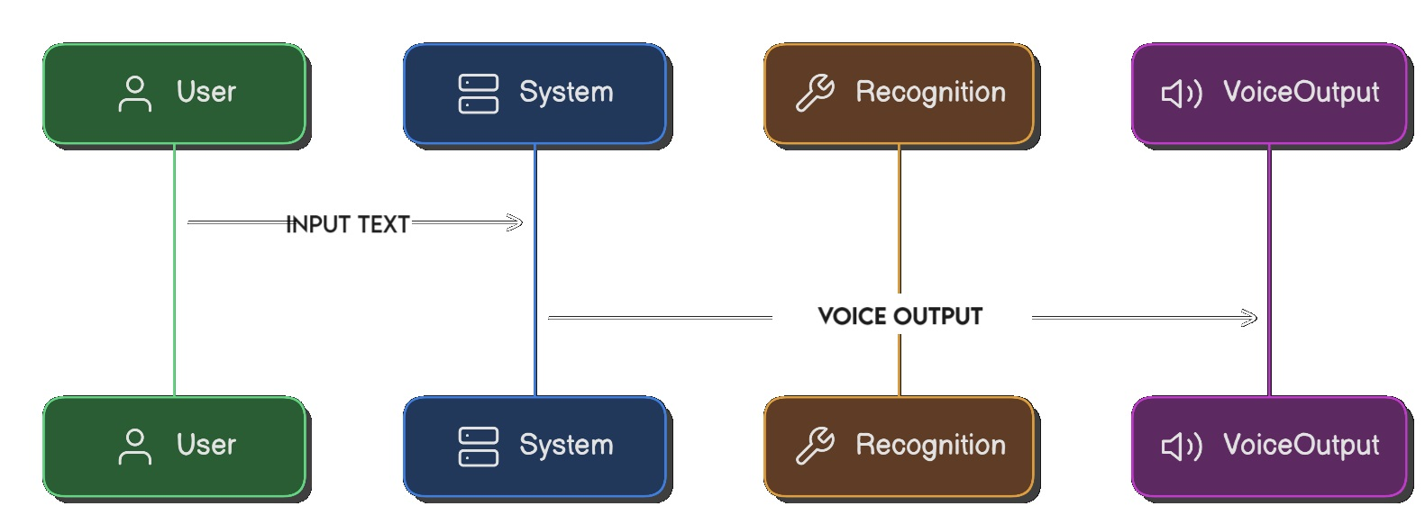
Proposed Architecture

Slide 8
Proposed Architecture - Description
This project uses Python to develop a text-to-voice conversion system, integrating Tkinter for the user interface, gTTS for text-to-speech conversion, and VS Code for development. Users can input text via a user-friendly GUI, which is then converted into audio files in multiple languages and dialects. This system enhances accessibility for visually impaired users, supports language learning, and can be used for automated announcements, showcasing the practical applications of text-to-speech technology.

Slide 9
Proposed Architecture - Description
This project harnesses the power of Python to create a text-to-voice conversion system. Through simple code, it transforms written text into spoken words, offering accessibility and usability benefits. Users can input any text, and the system generates corresponding audio files, accommodating multiple languages and dialects. This functionality is particularly valuable for visually impaired individuals, offering them an auditory alternative to written content. Moreover, the system's versatility extends to practical applications like automated announcements or integrating voice features into software interfaces

Slide 10
List of Modules
The Modules that I use are,
Tkinter
gTTS Library (Google Text to Speech Library)
Input Module
Output Module

Slide 11
Module Description
Tkinter: Tkinter is a standard GUI (Graphical User Interface) toolkit for Python.
It provides various widgets and tools to create interactive graphical interfaces. In this project, Tkinter will be used to design and develop the user interface for the text-to-voice conversion system.
gTTS (Google Text-to-Speech): gTTS is a Python library and CLI tool to interface with Google's Text-to-Speech API. It allows developers to generate audio files from text input using Google's powerful text-to-speech capabilities. In this project, gTTS will be utilized to convert written text into spoken words.

Slide 12
Module Description(Cont…)
Input Module (Tkinter):
Tkinter provides the tools necessary to create the user interface for inputting text. You'll design a text entry widget where users can type or paste the text they want to convert to speech.
This module will handle user interactions, such as clicking buttons to initiate the conversion process or clear the input field.
Output Module (gTTS):
gTTS will handle the conversion of the input text into audio output.
Once the user inputs the text and initiates the conversion process, gTTS will take that text and generate an audio file containing the spoken version.
The output module will ensure that the audio file is played back to the user, either through a built-in player or by saving the audio file for external playback.

Slide 13
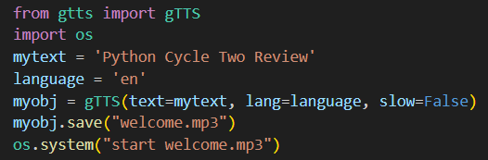

Results and Discussion
Coding :
Output :

Slide 14
Results and Discussion(Cont..)
The project integrates Tkinter for the user interface, gTTS for text-to-speech conversion, and VS Code for development. Tkinter's simplicity and flexibility enabled the creation of an intuitive UI, facilitating easy text input. gTTS seamlessly converted text to speech, providing audio output in various languages. VS Code's features streamlined development, aiding in code writing and debugging. The synergy between these modules resulted in a cohesive and user-friendly text-to-voice conversion system.

Slide 15
Conclusion
In conclusion, the project harnesses the combined power of Tkinter, gTTS, and VS Code to deliver a versatile text-to-voice conversion system. Beyond its technical prowess, this solution boasts a range of practical applications. For visually impaired individuals, it offers a lifeline by transforming written content into audible speech, enhancing accessibility to information. In educational settings, it facilitates language learning by providing pronunciation assistance and auditory reinforcement. Moreover, in public announcements or automated systems, it ensures clear and consistent delivery of messages.

Slide 16
REFERENCES
Rose, J. (2019). "Building Text-to-Speech Applications: gTTS and PyDub." Real Python. Available: https://realpython.com/build-python-text-to-speech-voice-app/.
Summerfield, M. (2009). Programming in Python 3: A Complete Introduction to the Python Language. Pearson Education.

Slide 17
Thank You
Any queries???

